Slide 1
Cryptography (2021 Fall) hash function, collision resistant, second preimage resistant, preimage resistant, Merkle-Damgård transform, hash-and-MAC
LiangFeng Zhang
zhanglf@shanghaitech.edu.cn
SIST, ShanghaiTech

Slide 2
(Cryptographic) Hash Function
Hash Table: hash functions in the course “data structures & algorithms”
$H: \{0,1\}^{∗}→\left[N\right]$ is a hash function -- store $x$ at location $H(x)$
look-up time: $O(1)$
collision: $x≠x^{′}, H\left(x\right)=H(x′)$
as few collisions as possible
DEFINITION: a hash function is a pair $Π=(Gen, H)$ of PPT algorithms
$s←Gen(1^{n})$: key generation
$H^{s}:{\left\{0,1\right\}}^{∗}→{\left\{0,1\right\}}^{l(n)}$
fixed-length for inputs of length $l′(n)$: $H^{s}$ is only defined on ${\left\{0,1\right\}}^{l^{′}(n)},$ where $l^{′}\left(n\right)>l(n)$
A fixed-length hash function is also called a compression function
The key $s$ is not private. It is public.

Slide 3



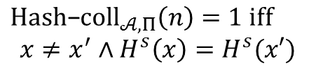


Collision Resistance
The Collision-Finding Experiment $Hash$-$coll_{𝒜,Π}(n)$:
$$s←Gen\left(1^{n}\right)$$
$$s$$
$$Challenger$$
$$Adversary 𝒜$$
$$x,x^{′}$$
$$Hash\text{−}coll_{𝒜,Π}\left(n\right)=1 iff$$
$$x≠x^{′}∧H^{s}\left(x\right)=H^{s}(x′)$$

Slide 4
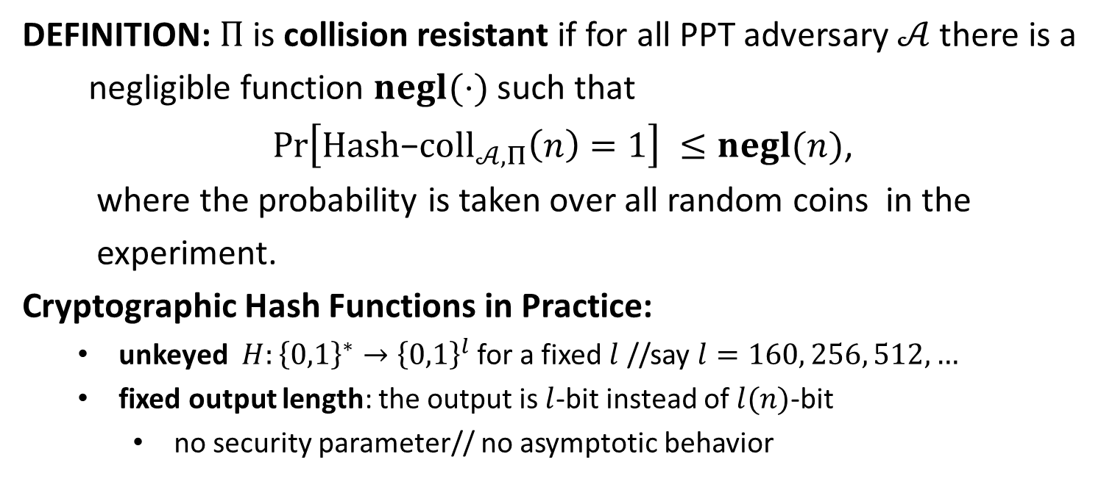
Collision Resistance
DEFINITION: $Π$is collision resistant if for all PPT adversary $𝒜$ there is a
negligible function $negl(⋅)$ such that
$\operatorname{Pr}\left[Hash\text{−}coll_{𝒜,Π}\left(n\right)=1\right] ≤negl(n)$,
where the probability is taken over all random coins in the
experiment.
Cryptographic Hash Functions in Practice:
unkeyed $H:{\left\{0,1\right\}}^{∗}→{\left\{0,1\right\}}^{l}$ for a fixed $l$ //say $l=160, 256, 512,…$
fixed output length: the output is $l$-bit instead of $l(n)$-bit
no security parameter// no asymptotic behavior

Slide 5



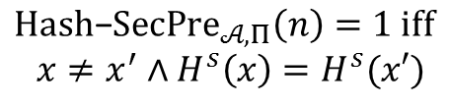
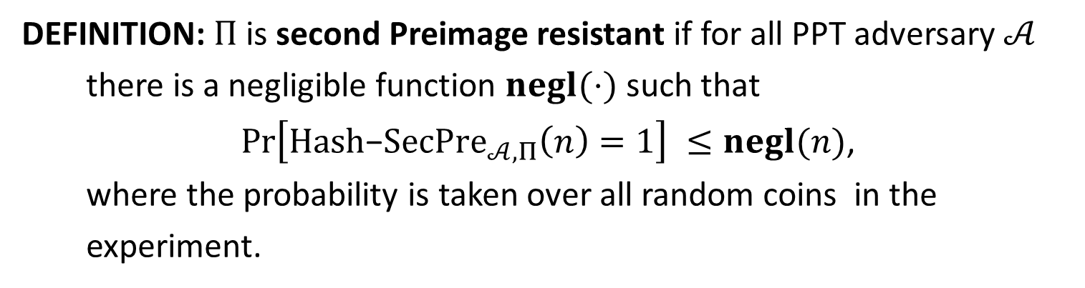


Second-Preimage Resistance
The Second Preimage-Finding Experiment $Hash$-$Sec{Pre}_{𝒜,Π}(n)$:
$$s←Gen\left(1^{n}\right)$$
$$x←{\left\{0,1\right\}}^{l^{′}(n)}$$
$$s,x$$
$$Challenger$$
$$Adversary 𝒜$$
$$x^{′}$$
$$Hash\text{−}SecPre_{𝒜,Π}\left(n\right)=1 iff$$
$$x≠x^{′}∧H^{s}\left(x\right)=H^{s}(x′)$$
DEFINITION: $Π$is second Preimage resistant if for all PPT adversary $𝒜$
there is a negligible function $negl(⋅)$ such that
$\operatorname{Pr}\left[Hash\text{−}SecPre_{𝒜,Π}\left(n\right)=1\right] ≤negl(n)$,
where the probability is taken over all random coins in the
experiment.

Slide 6



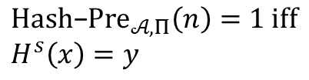
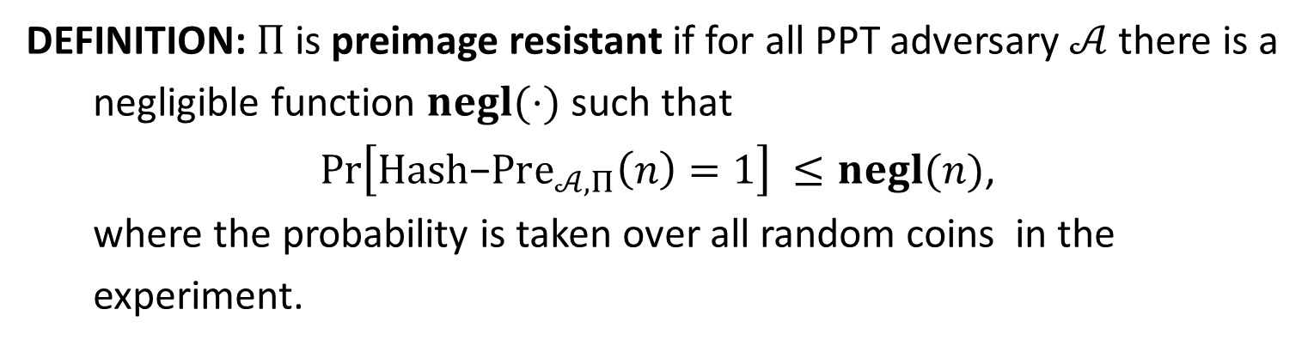
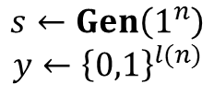

Preimage Resistance
The Preimage-Finding Experiment $Hash$-${Pre}_{𝒜,Π}(n)$:
$$s←Gen\left(1^{n}\right)$$
$$y←{\left\{0,1\right\}}^{l(n)}$$
$$s,y$$
$$Challenger$$
$$Adversary 𝒜$$
$$x$$
$$Hash\text{−}Pre_{𝒜,Π}\left(n\right)=1 iff$$
$$H^{s}\left(x\right)=y$$
DEFINITION: $Π$is preimage resistant if for all PPT adversary $𝒜$ there is a
negligible function $negl(⋅)$ such that
$\operatorname{Pr}\left[Hash\text{−}Pre_{𝒜,Π}\left(n\right)=1\right] ≤negl(n)$,
where the probability is taken over all random coins in the
experiment.

Slide 7
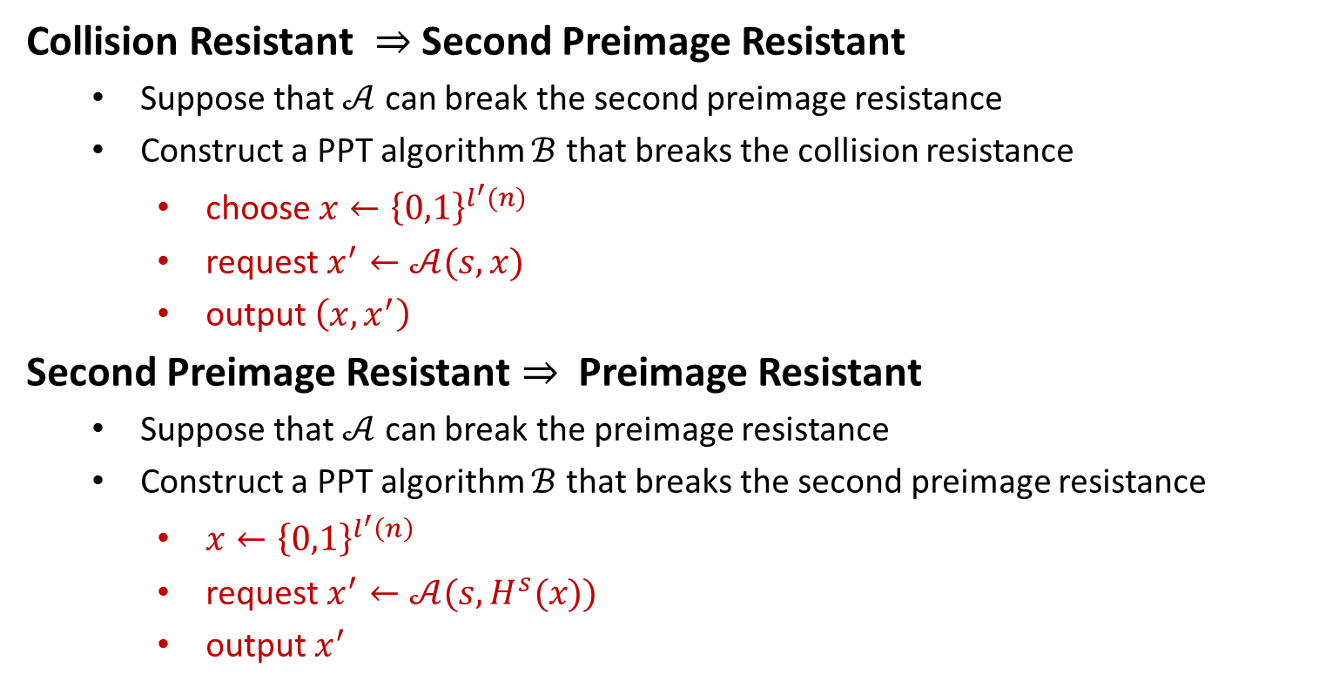
On the Security Levels
Collision Resistant $⇒$ Second Preimage Resistant
Suppose that $𝒜$ can break the second preimage resistance
Construct a PPT algorithm $ℬ$ that breaks the collision resistance
choose $x←{\left\{0,1\right\}}^{l^{′}(n)}$
request $x^{′}←𝒜(s,x)$
output $\left(x,x^{′}\right)$
Second Preimage Resistant $⇒$ Preimage Resistant
Suppose that $𝒜$ can break the preimage resistance
Construct a PPT algorithm $ℬ$ that breaks the second preimage resistance
$x←{\left\{0,1\right\}}^{l^{′}\left(n\right)}$
request $x^{′}←𝒜(s,H^{s}(x))$
output $x^{′}$

Slide 9


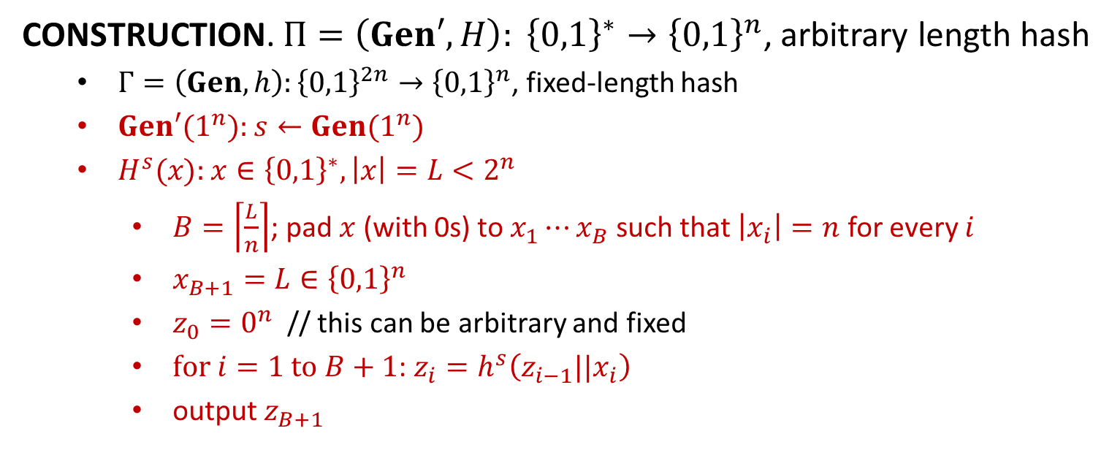












Merkle-Damgård Transform
$$x_{1}$$
$$x_{2}$$
$$⋯$$
$$x_{B}$$
$$x_{B+1}=L$$
$$z_{0}$$
$$h^{s}$$
$$h^{s}$$
$$⋯$$
$$h^{s}$$
$$h^{s}$$
$$H^{s}\left(x\right)=z_{B+1}$$
$$z_{1}$$
$$z_{2}$$
$$z_{B}$$
CONSTRUCTION. $Π=\left(Gen′, H\right): {\left\{0,1\right\}}^{∗}→{\left\{0,1\right\}}^{n}$, arbitrary length hash
$Γ=\left(Gen,h\right):{\left\{0,1\right\}}^{2n}→{\left\{0,1\right\}}^{n}$, fixed-length hash
$Gen′(1^{n}):$ $s←Gen(1^{n})$
$H^{s}(x):$ $x∈{\left\{0,1\right\}}^{∗}, \left|x\right|=L<2^{n}$
$B=\left\lceil \frac{L}{n}\right\rceil$; pad $x$ (with 0s) to $x_{1}⋯x_{B}$ such that $\left|x_{i}\right|=n$ for every $i$
$x_{B+1}=L∈{\left\{0,1\right\}}^{n}$
$z_{0}=0^{n}$ // this can be arbitrary and fixed
$for i=1 to B+1$: $z_{i}=h^{s}\left(z_{i−1}||x_{i}\right)$
output $z_{B+1}$
Examples: MD5; SHA family

Slide 10

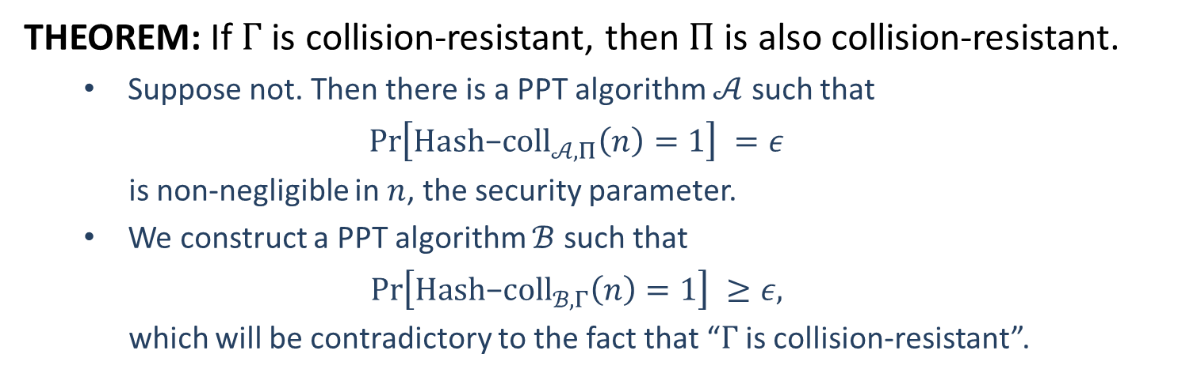






Merkle-Damgård Transform
THEOREM: If $Γ$ is collision-resistant, then $Π$ is also collision-resistant.
Suppose not. Then there is a PPT algorithm $𝒜$ such that
$$\operatorname{Pr}\left[Hash\text{−}coll_{𝒜,Π}\left(n\right)=1\right] =ε$$
is non-negligible in $n$, the security parameter.
We construct a PPT algorithm $ℬ$ such that
$$\operatorname{Pr}\left[Hash\text{−}coll_{ℬ,Γ}\left(n\right)=1\right] ≥ε,$$
which will be contradictory to the fact that “$Γ$ is collision-resistant”.
$$s←Gen\left(1^{n}\right)$$
$$s$$
$$s$$
?
$$(x,x^{′})$$
$$(y,y^{′})$$
challenger
$$ℬ$$
$$𝒜$$

Slide 11




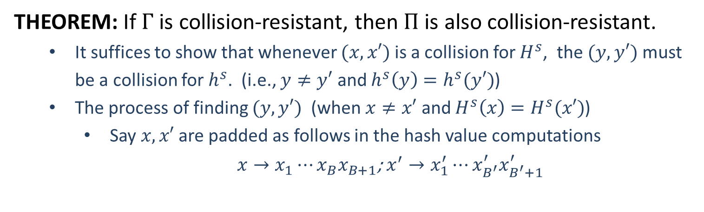
























Merkle-Damgård Transform
THEOREM: If $Γ$ is collision-resistant, then $Π$ is also collision-resistant.
It suffices to show that whenever $(x,x′)$ is a collision for $H^{s}$, the $(y,y′)$ must be a collision for $h^{s}$. (i.e., $y≠y′$ and $h^{s}\left(y\right)=h^{s}(y′)$)
The process of finding $(y,y′)$ (when $x≠x′$ and $H^{s}\left(x\right)=H^{s}(x′)$)
Say $x,x′$ are padded as follows in the hash value computations
$x→x_{1}⋯x_{B}x_{B+1}$; $x^{′}→x_{1}^{′}⋯x_{B^{′}}^{′}x_{B^{′}+1}^{′}$
$$x_{1}$$
$$x_{2}$$
$$⋯$$
$$x_{B}$$
$$x_{B+1}$$
$$z_{0}$$
$$h^{s}$$
$$h^{s}$$
$$⋯$$
$$h^{s}$$
$$h^{s}$$
$$H^{s}\left(x\right)$$
$$z_{1}$$
$$z_{2}$$
$$z_{B}$$
$$x_{1}^{′}$$
$$x_{2}^{′}$$
$$⋯$$
$$x_{B^{′}}^{′}$$
$$x_{B^{′}+1}^{′}$$
$$z_{0}^{′}$$
$$h^{s}$$
$$h^{s}$$
$$⋯$$
$$h^{s}$$
$$h^{s}$$
$$H^{s}\left(x′\right)$$
$$z_{1}^{′}$$
$$z_{2}^{′}$$
$$z_{B^{′}}^{′}$$

Slide 12
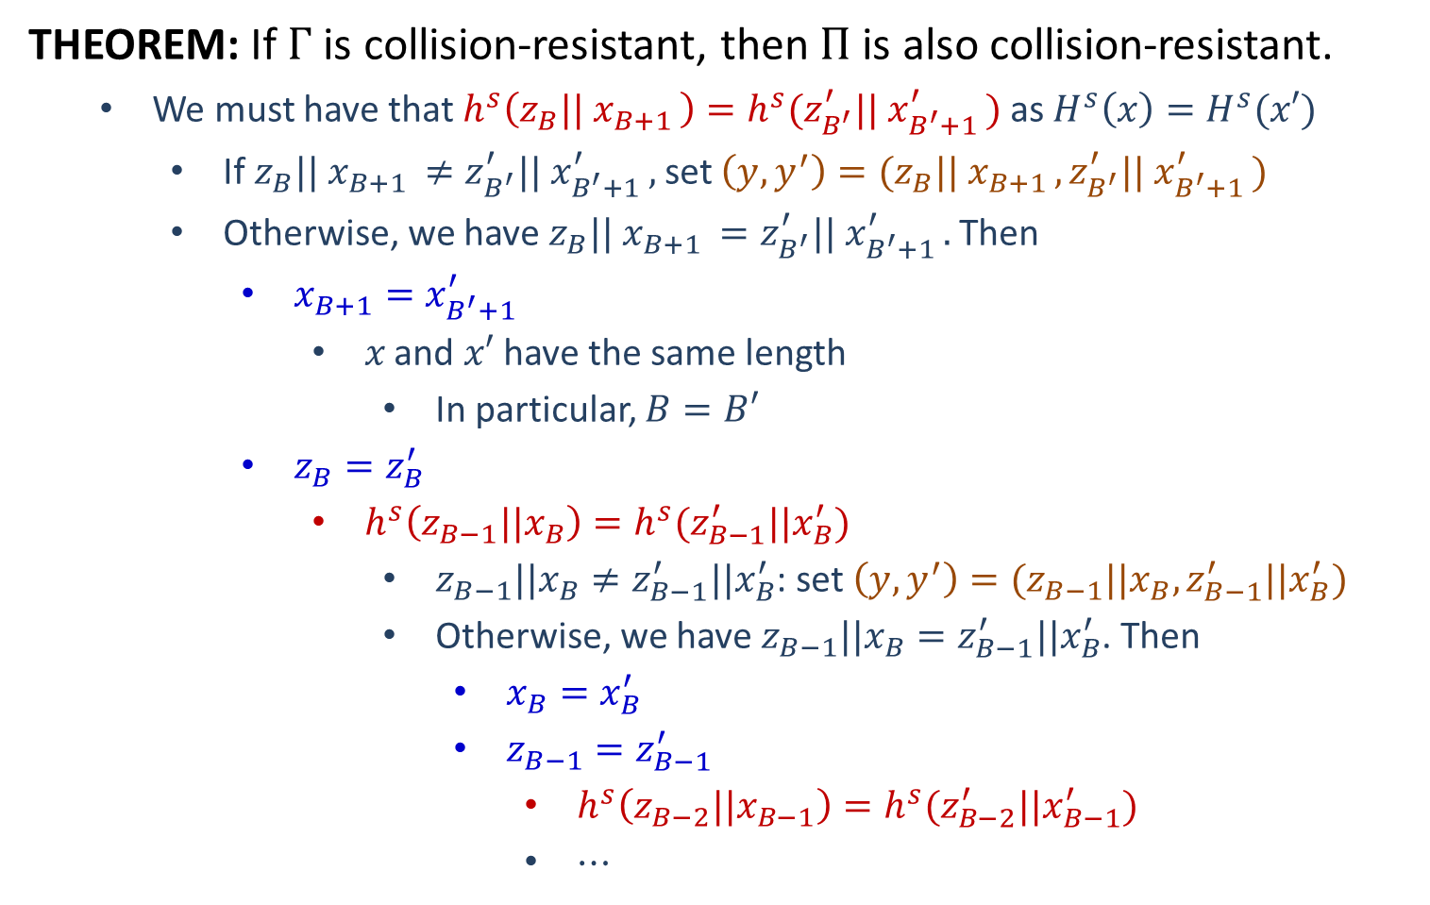
Merkle-Damgård Transform
THEOREM: If $Γ$ is collision-resistant, then $Π$ is also collision-resistant.
We must have that $h^{s}\left(z_{B}|| x_{B+1 }\right)=h^{s}(z_{B^{′}}^{′}|| x_{B^{′}+1 }^{′})$ as $H^{s}\left(x\right)=H^{s}(x′)$
If $z_{B}|| x_{B+1 }≠z_{B^{′}}^{′}|| x_{B^{′}+1 }^{′},$ set $\left(y,y^{′}\right)=(z_{B}|| x_{B+1 },z_{B^{′}}^{′}|| x_{B^{′}+1 }^{′})$
Otherwise, we have $z_{B}|| x_{B+1 }=z_{B^{′}}^{′}|| x_{B^{′}+1 }^{′}.$ Then
$x_{B+1}=x_{B^{′}+1}^{′}$
$x$ and $x′$ have the same length
In particular, $B=B′$
$z_{B}=z_{B}^{′}$
$h^{s}\left(z_{B−1}||x_{B}\right)=h^{s}(z_{B−1}^{′}||x_{B}^{′})$
$z_{B−1}||x_{B}≠z_{B−1}^{′}||x_{B}^{′}$: set $\left(y,y^{′}\right)=(z_{B−1}||x_{B},z_{B−1}^{′}||x_{B}^{′})$
Otherwise, we have $z_{B−1}||x_{B}=z_{B−1}^{′}||x_{B}^{′}$. Then
$x_{B}=x_{B}^{′}$
$z_{B−1}=z_{B−1}^{′}$
$h^{s}\left(z_{B−2}||x_{B−1}\right)=h^{s}(z_{B−2}^{′}||x_{B−1}^{′})$
$⋯$

Slide 13
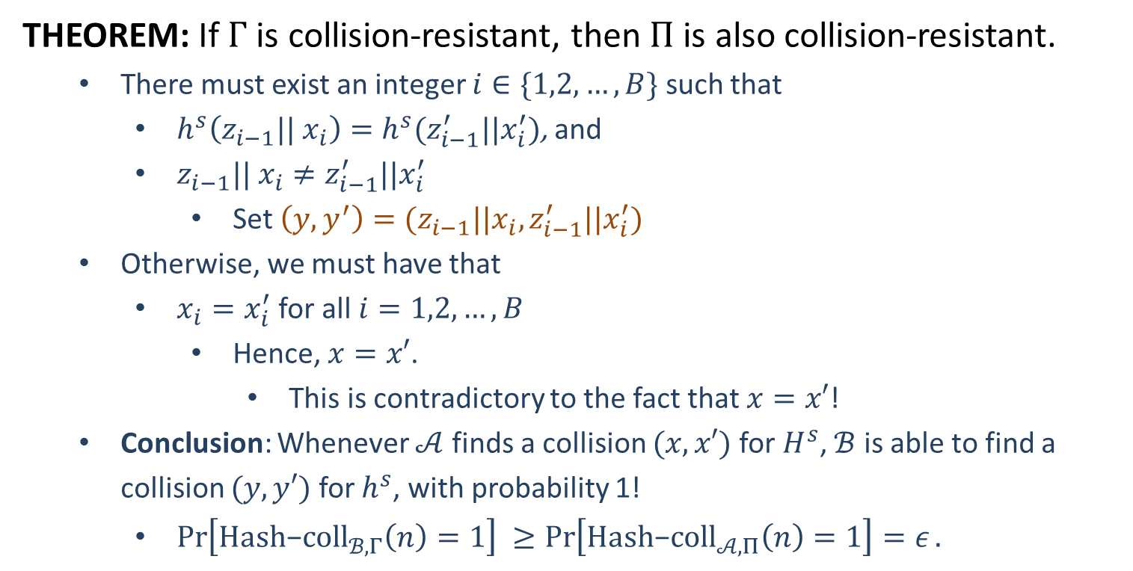
Merkle-Damgård Transform
THEOREM: If $Γ$ is collision-resistant, then $Π$ is also collision-resistant.
There must exist an integer $i∈\{1,2,…,B\}$ such that
$h^{s}\left(z_{i−1}|| x_{i}\right)=h^{s}(z_{i−1}^{′}||x_{i}^{′})$, and
$z_{i−1}|| x_{i}≠z_{i−1}^{′}||x_{i}^{′}$
Set $\left(y,y^{′}\right)=(z_{i−1}||x_{i},z_{i−1}^{′}||x_{i}^{′})$
Otherwise, we must have that
$x_{i}=x_{i}^{′}$ for all $i=1,2,…,B$
Hence, $x=x′$.
This is contradictory to the fact that $x=x′$!
Conclusion: Whenever $𝒜$ finds a collision $(x,x′)$ for $H^{s}$, $ℬ$ is able to find a collision $(y,y′)$ for $h^{s}$, with probability 1!
$\operatorname{Pr}\left[Hash\text{−}coll_{ℬ,Γ}\left(n\right)=1\right] ≥\operatorname{Pr}\left[Hash\text{−}coll_{𝒜,Π}\left(n\right)=1\right]=ε.$

Slide 15
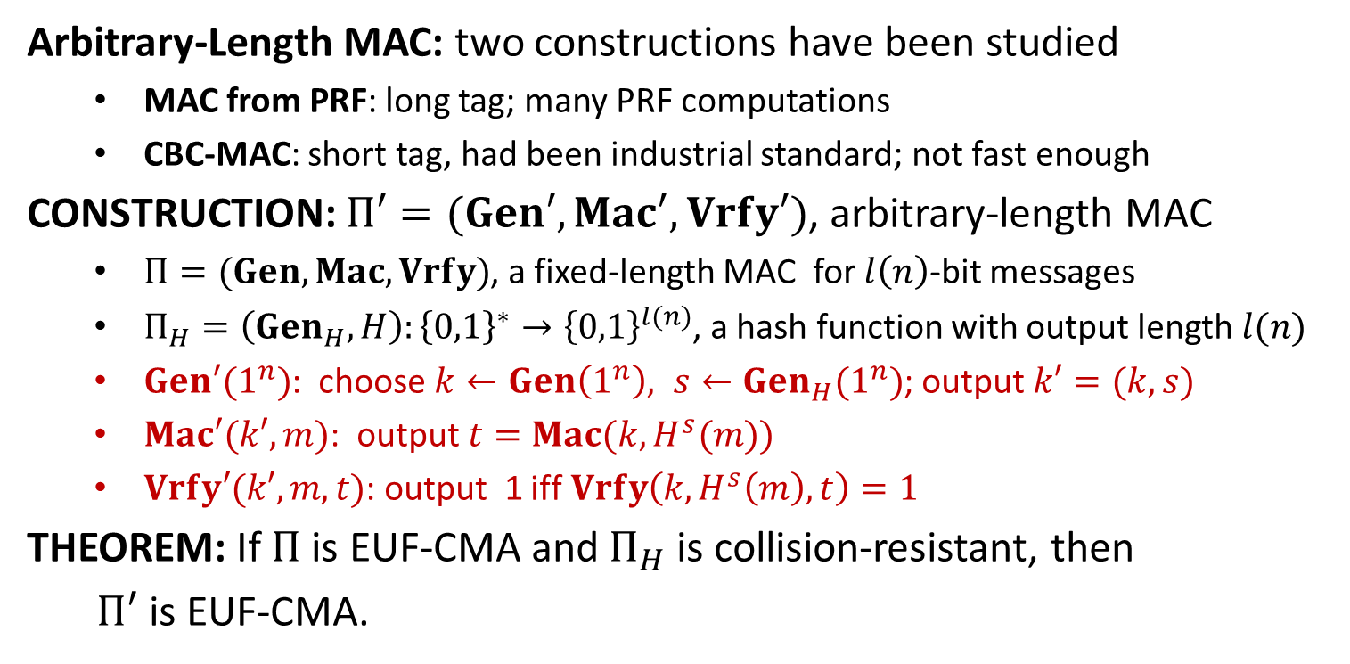
Hash-and-MAC
Arbitrary-Length MAC: two constructions have been studied
MAC from PRF: long tag; many PRF computations
CBC-MAC: short tag, had been industrial standard; not fast enough
CONSTRUCTION: $Π′=(Gen′,Mac′, Vrfy′)$, arbitrary-length MAC
$Π=(Gen, Mac, Vrfy)$, a fixed-length MAC for $l\left(n\right)$-bit messages
$Π_{H}=\left(Gen_{H}, H\right):{\left\{0,1\right\}}^{∗}→{\left\{0,1\right\}}^{l(n)}$, a hash function with output length $l(n)$
$Gen′(1^{n})$: choose $k←Gen\left(1^{n}\right), s←Gen_{H}(1^{n})$; output $k′=(k,s)$
$Mac′(k′,m)$: output $t=Mac(k, H^{s}(m))$
$Vrfy′(k′,m,t)$: output 1 iff $Vrfy\left(k,H^{s}\left(m\right),t\right)=1$
THEOREM: If $Π$ is EUF-CMA and $Π_{H}$ is collision-resistant, then
$Π′$ is EUF-CMA.

